Slide 1

Pizza My Heart
Team – The Go Getters
CMPE281

Slide 2
Team Members
Anjana Menon
Naman Agrawal
Pavani Somarouthu
Kowshhal Uppu
Shivangi Jain

Slide 3
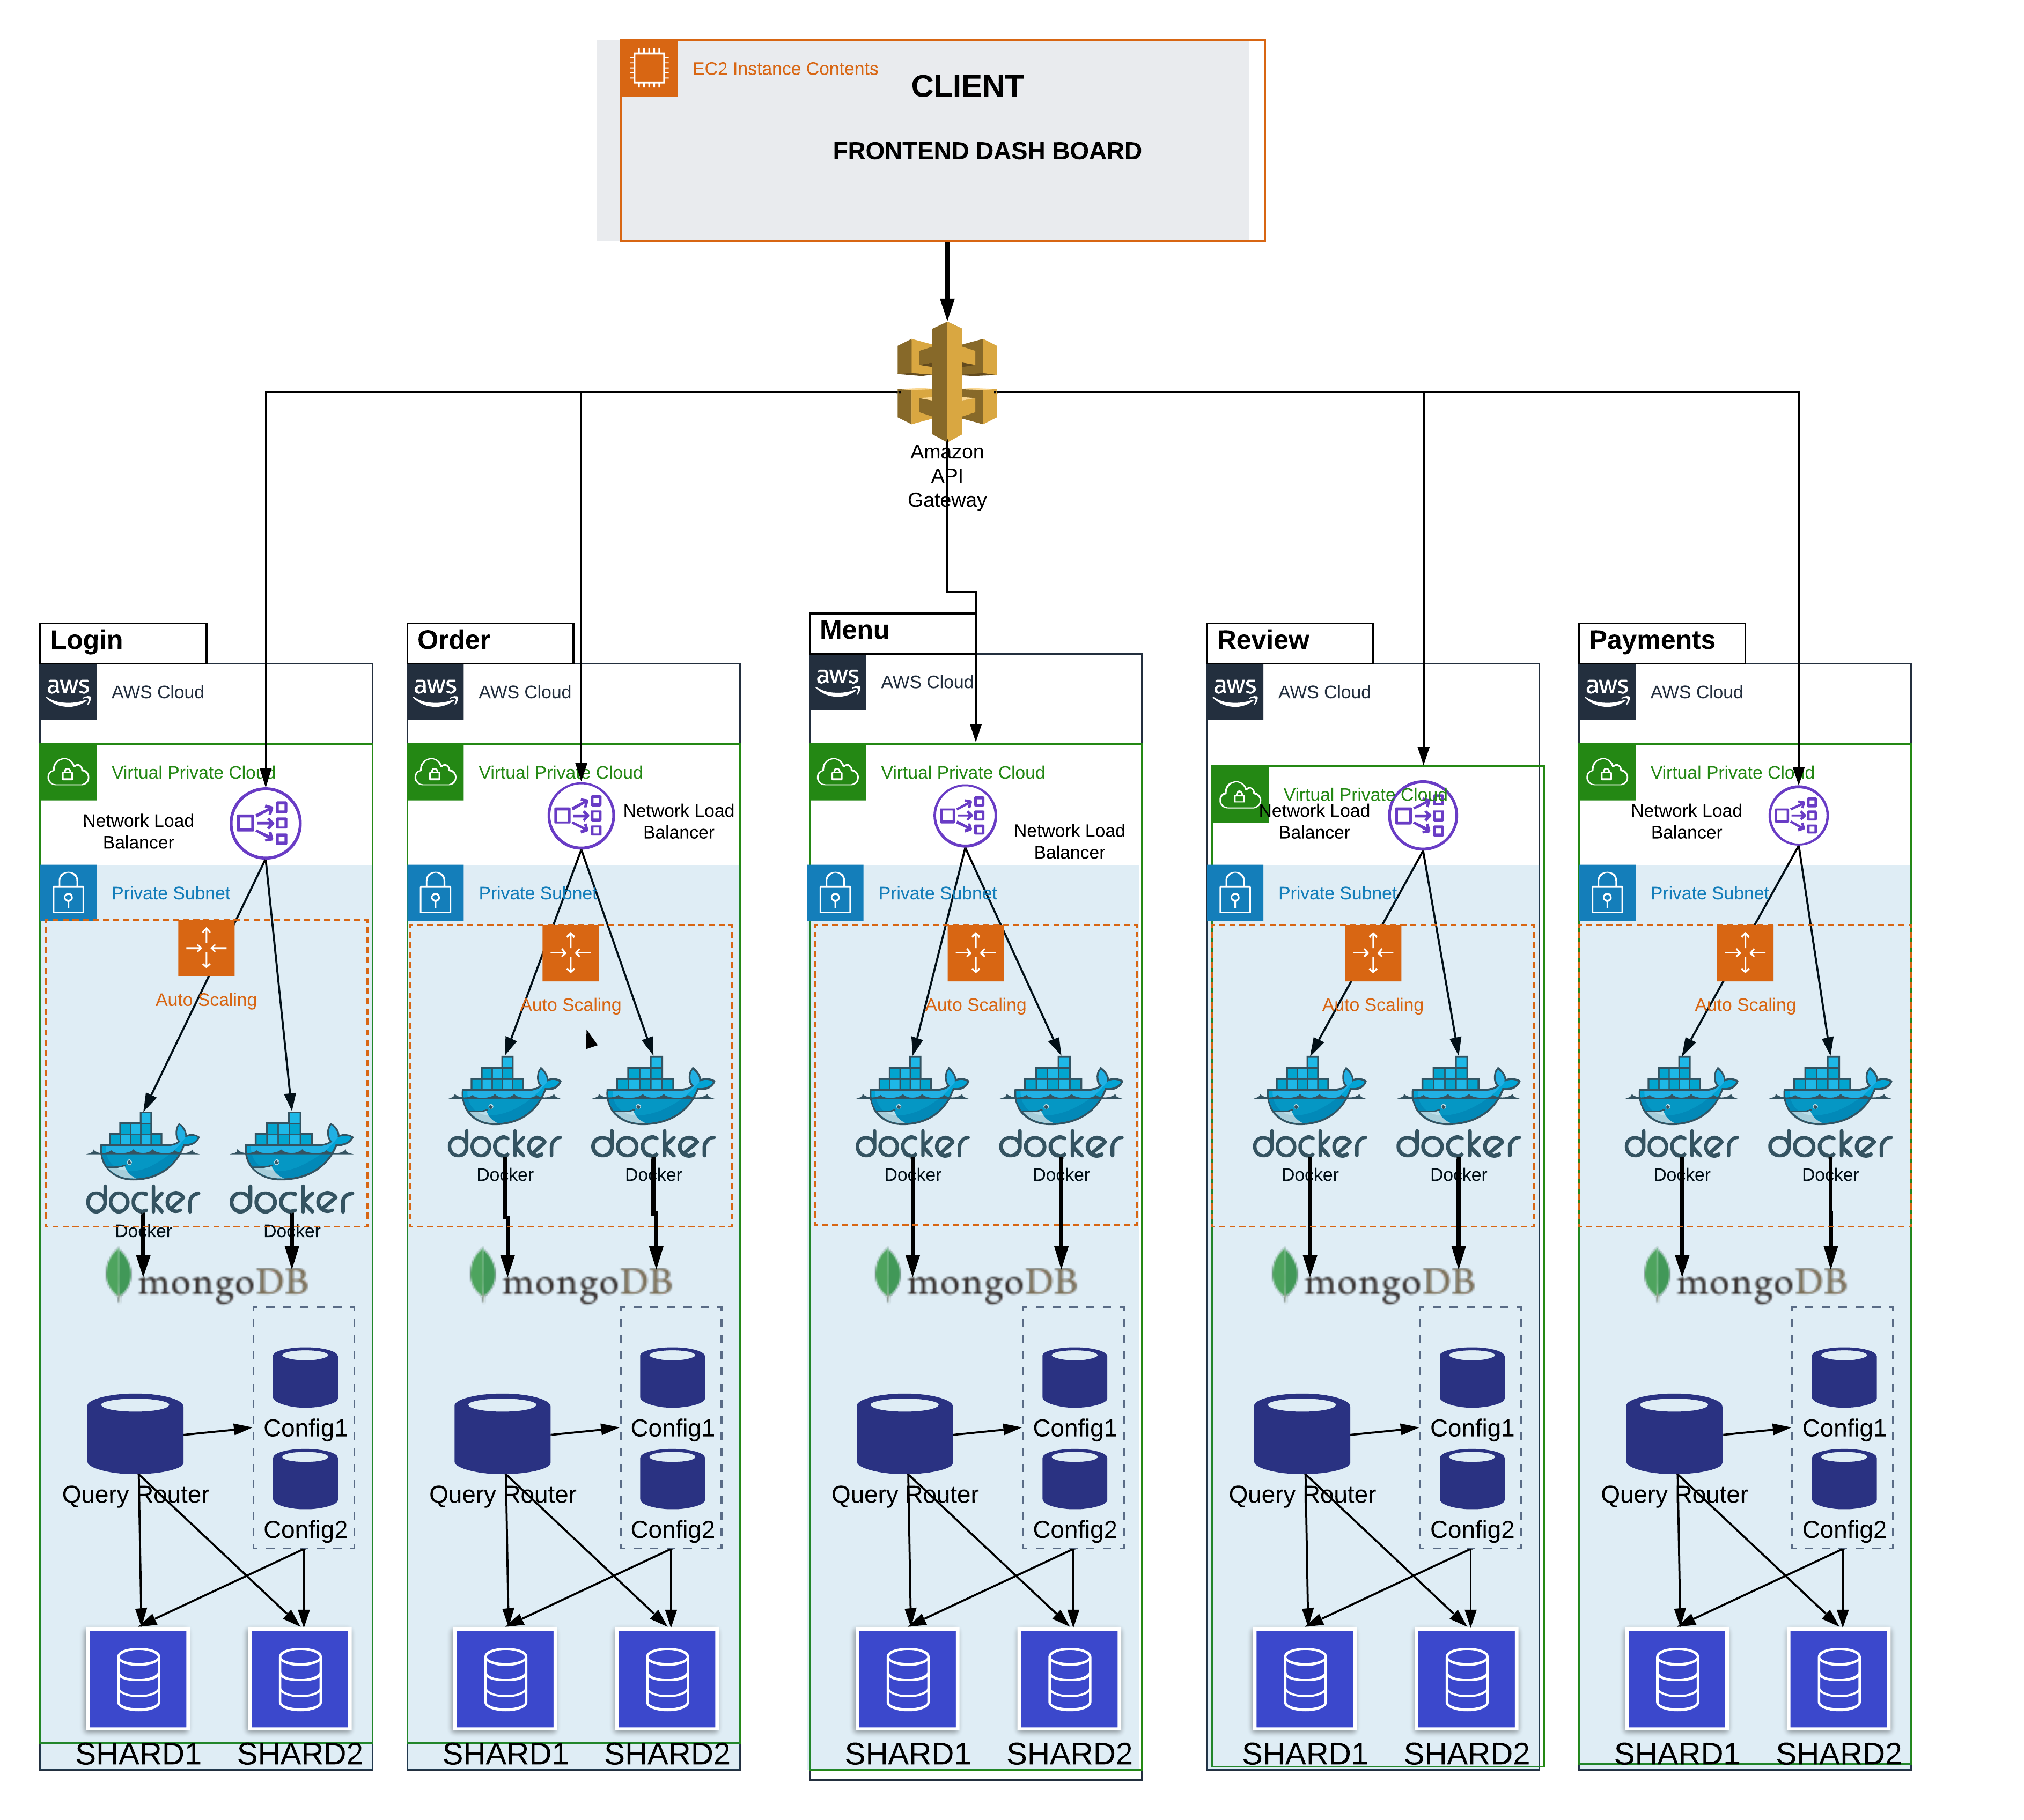
Architecture Diagram

Slide 4
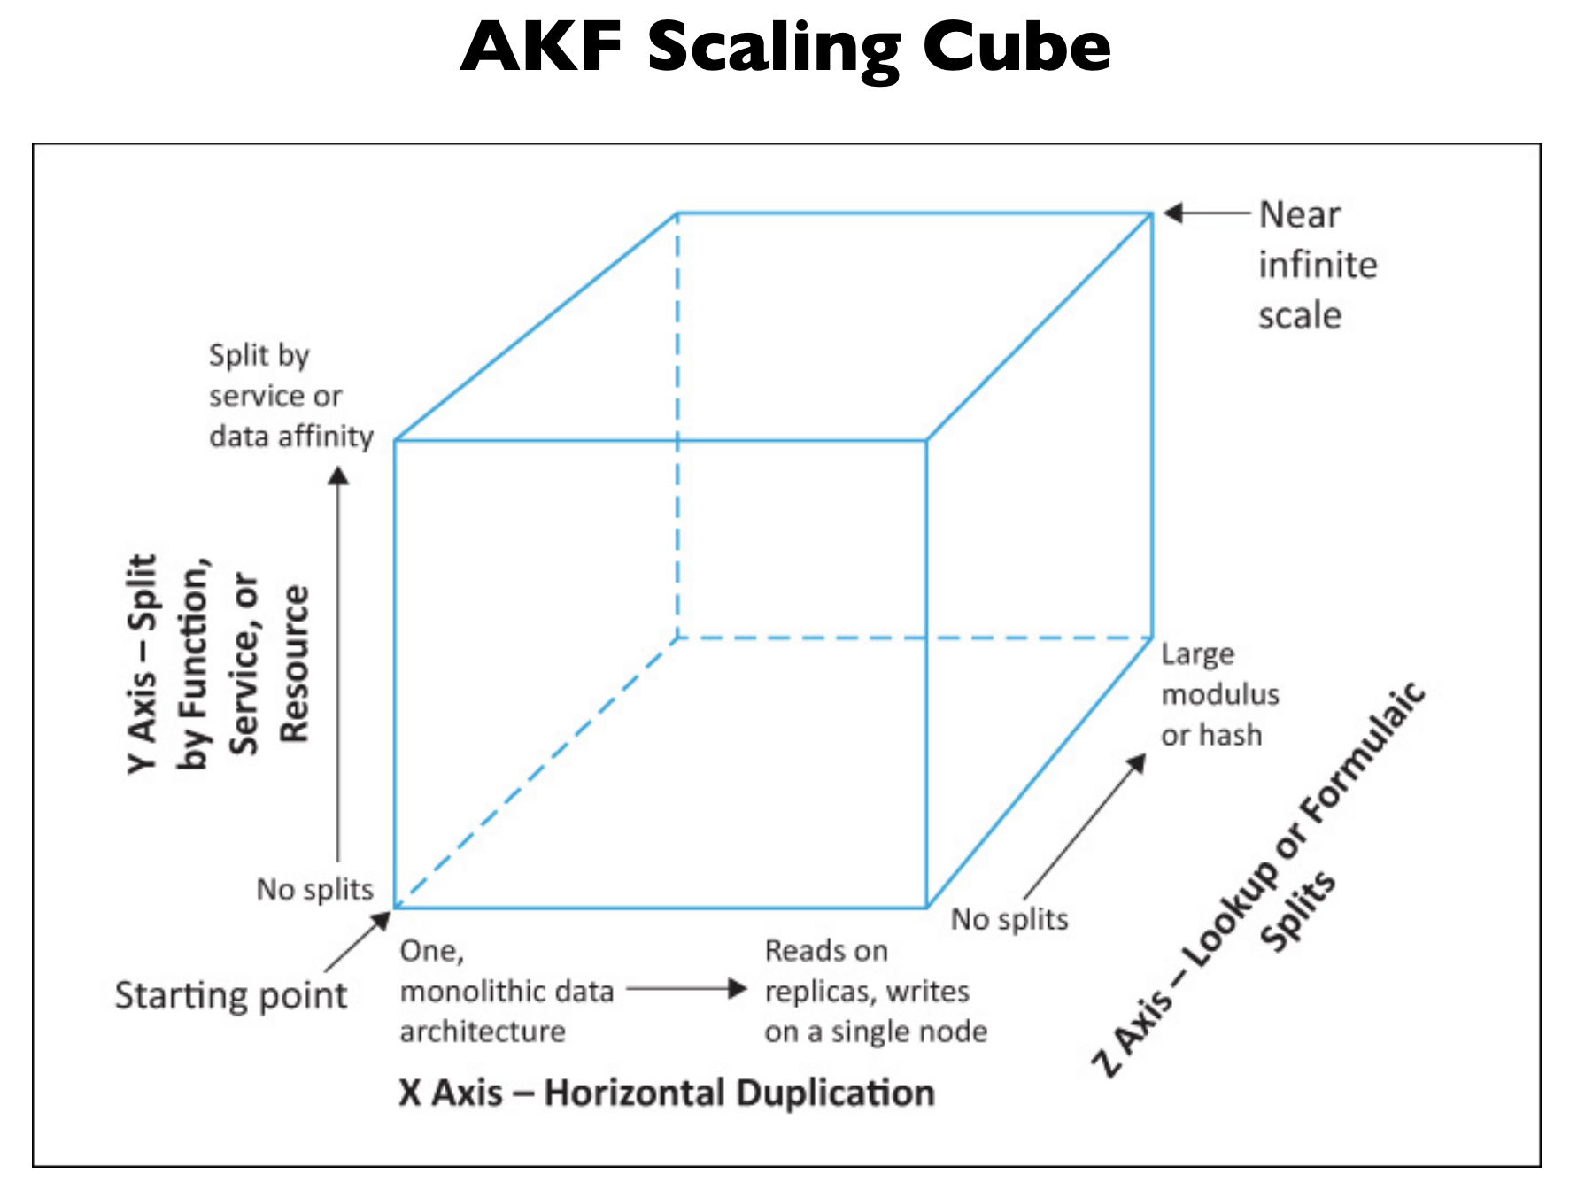
AKF Cube Scaling
X AXIS
Replication through multiple nodes.
No Single Point of Failure
Y AXIS
Split by function, service or resource
Z AXIS
Data Split (Sharding)

Slide 5
Features
Amazon Cloud Front End
AWS EC2 instances for Microservices
MongoDB - Sharding
Auto-Scaling Docker hosts
Network Load Balancers
Wow Factors

Slide 6

DEMO

